Slide 1

Basic Internship
Report of Basic Internship
Social Media
Website
Nguyen Duc Anh Tu - B21DCVT442

Slide 2



Basic Internship
TABLES OF CONTENTS
I. Overview
II. System Analysis and Design
III. Project Management
IV. Project Demo

Slide 3

Basic Internship
I. Overview
Reason for choosing topic
In today's rapidly advancing technological landscape, information technology plays a crucial role in societal development, with applications spanning healthcare, education, and daily life. The project focuses on "Building a Social Media Website" to create an online website that fosters connectivity, communication, and collaboration.

Slide 4

Basic Internship
About Technologies
Frontend: HTML, CSS, Javascript, Reactjs, Redux, MUI, Formik
Backend: Java, Spring framework
Database: MySQL

Slide 5
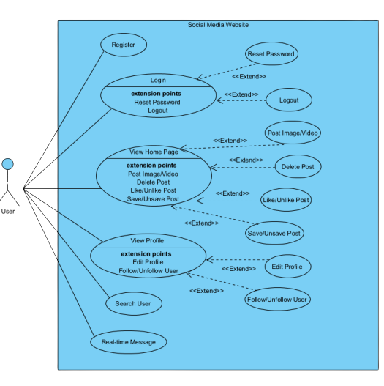
Basic Internship
II. System Analysis and Design
Use case diagram
This use case diagram outlines core functionalities for a social media platform, enabling users to:
Account Management: Register, login, reset password, and log out.
Content Interaction: View and post content (images/videos), delete posts, like/unlike, save/unsave, and comment.
Social Connections: View and edit profiles, follow/unfollow users, and search for other users.
Messaging: Send and receive real-time messages.

Slide 6
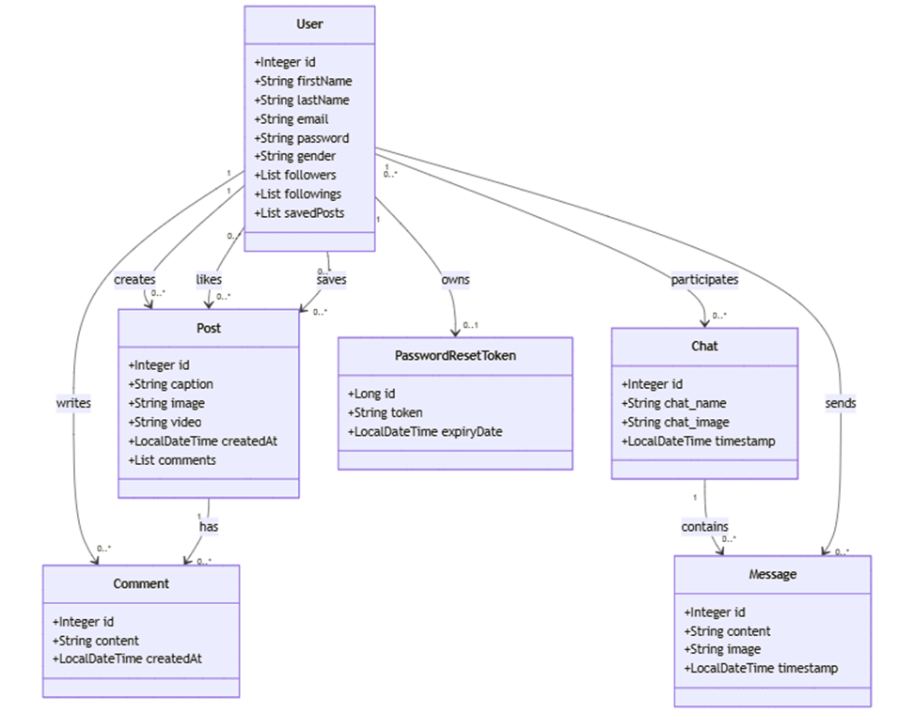
Basic Internship
Entity class diagram
User-Post: A user can create, like, save, and own multiple posts. A user can also participate in multiple chats.
Post-Comment: A post can have multiple comments.
Chat-Message: A chat can contain multiple messages.
User-Chat: A user can participate in multiple chats.

Slide 7
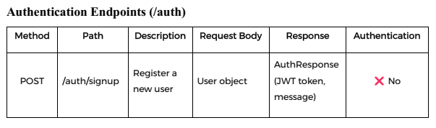
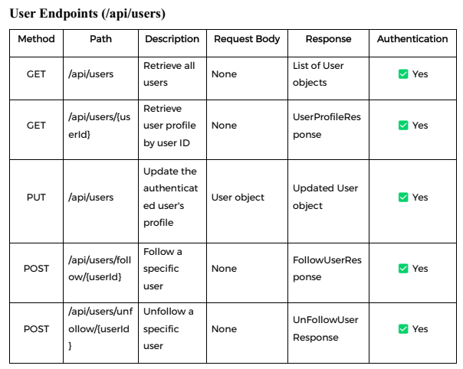
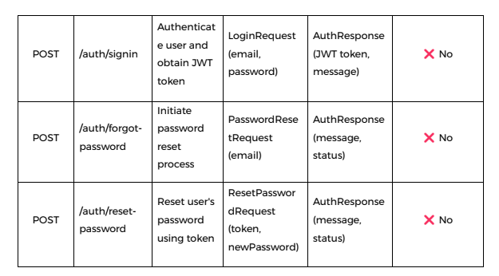
Basic Internship

Slide 8
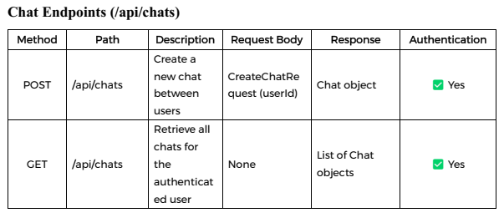
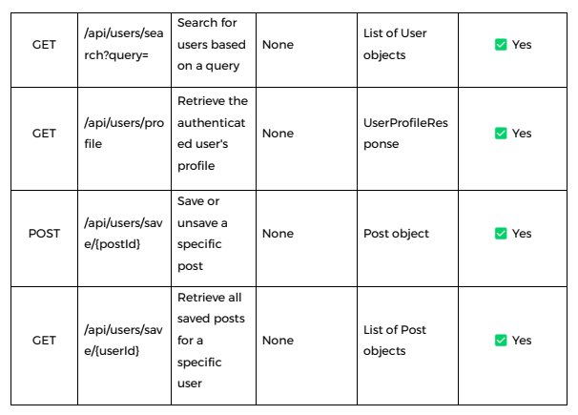
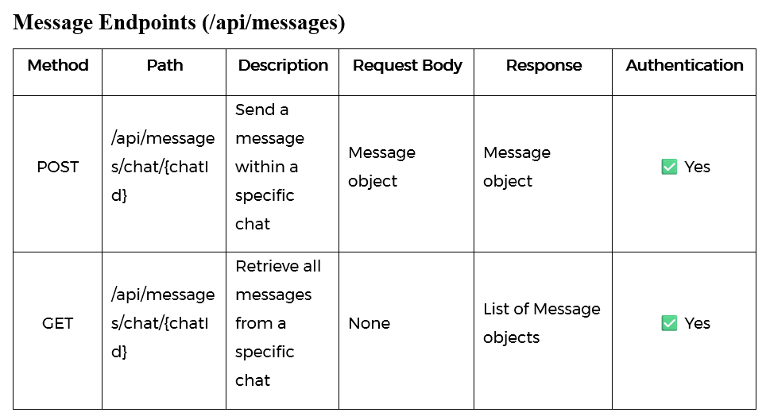
Basic Internship

Slide 9
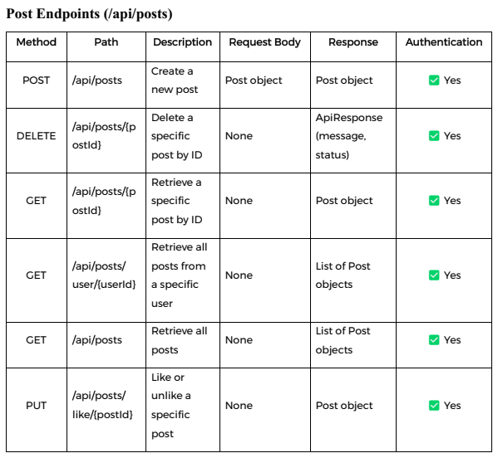
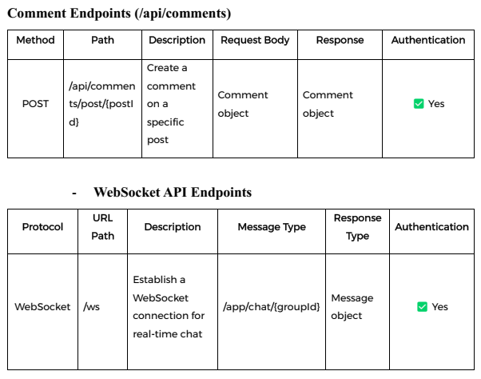
Basic Internship

Slide 10



Basic Internship
III. Project Management
Exploring technology
Testing
W4-08/2024 + W1, W2 09/2024
10/2024 + W1, W2, W3-11/2024
Research and evaluation of relevant technologies.
Ensuring quality and fix bug.
Planning
Development
W3, W4 09/2024
W4-11/2024 +
W1-12/2024
Laying the foundation for the project.
Building the core functionalities.

Slide 11

Basic Internship
IV. DEMO PROJECT

Slide 12


Basic Internship
Thank You For Your Attention!
STUDENT
STUDENT ID
Nguyen Duc Anh Tu
B21DCVT442

